Slide 1


Project Progress Report 4 Database Management for Business Analytics BANL 6430-03
Team members:
Giacomo Bizzotto, Rishitha Thatipally, Irfan Shaik, Errolla Vivek, Shraddha Shakya, Sampath Sai Raghav Allaboyina

Slide 2
Question 1: Passengers Prediction per Staging Facilities
ETS Model
High-demand facilities (Goethals, Bayonne)
Annual passenger volume stabilizing at ~155 million
Low-demand facilities (Outerbridge, GWB PIP)

Slide 3
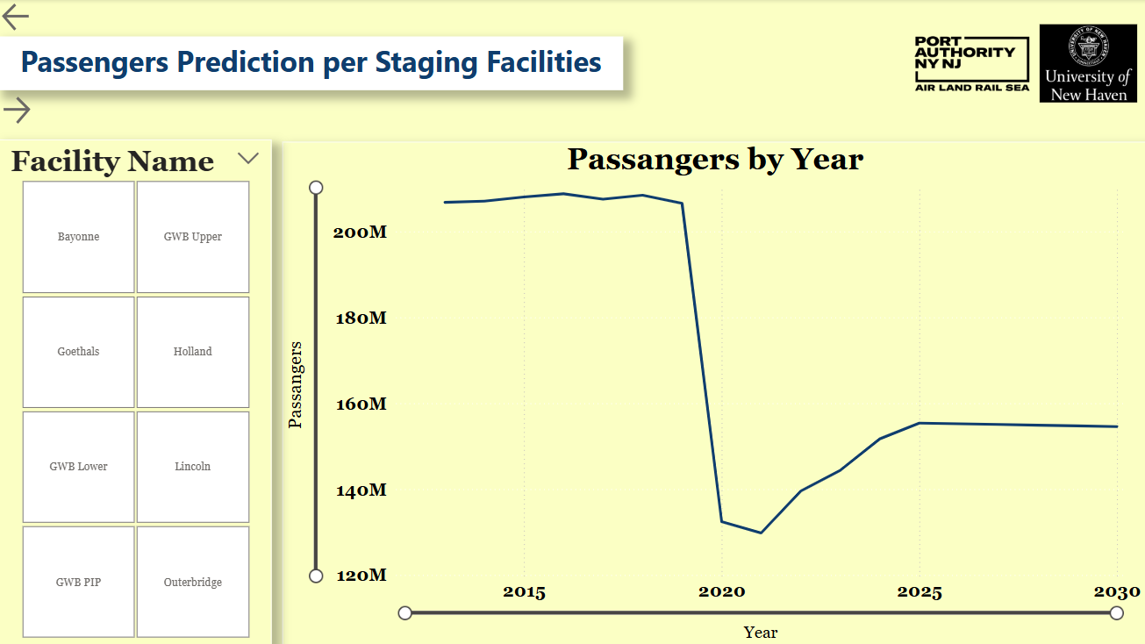
Bus Passengers per Facility

Slide 4
Question 2: the most important factors in predicting the number of passengers
Time-based variables Weekly, monthly, and yearly passenger volumes were the most important predictors of bus terminal ridership
Weather variables Slightly improved short-term accuracy but had minimal impact on long-term forecasts

Slide 5
Question 3: Project the prediction results by the individual carrier
Prophet forecasts reveal NJ Transit and Coach USA as top carriers requiring prioritized and expanded staging support during peak periods.
Smaller and flat-growth carriers like C&J Bus Lines and Martz need minimal or flexible staging.

Slide 6
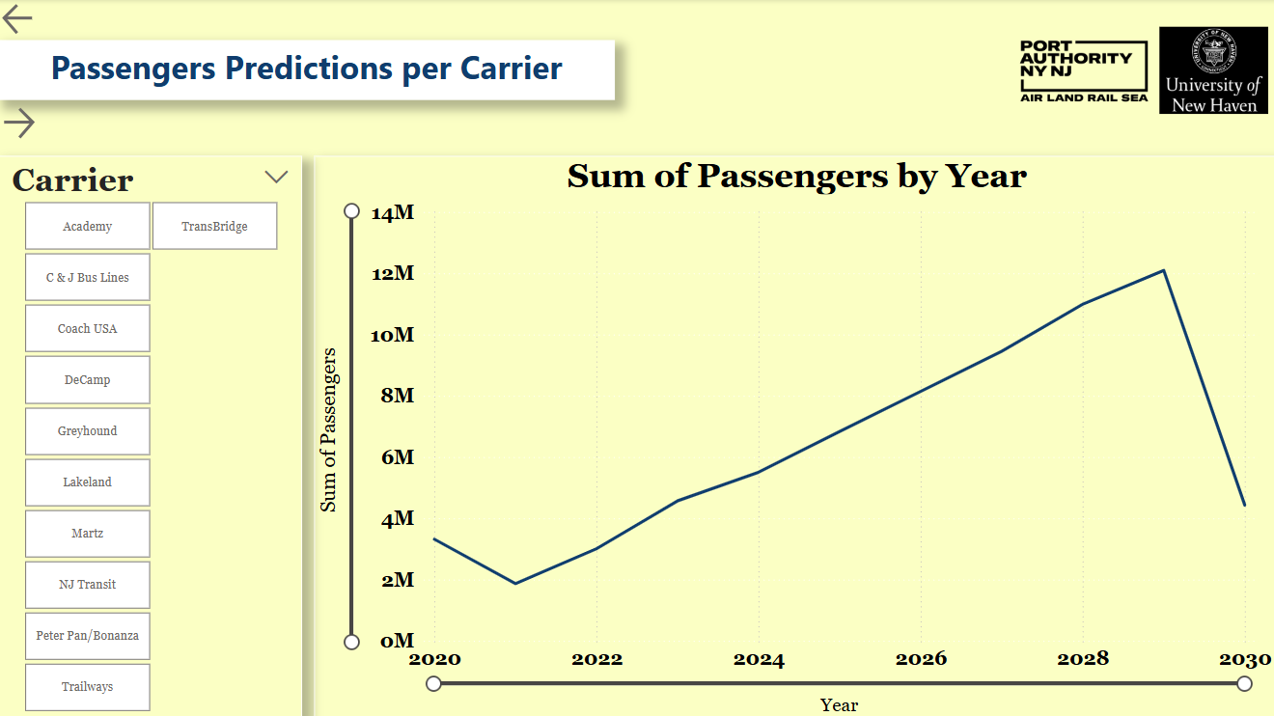

Slide 7
Question 4: What would be the busiest time for the bus terminal staging facilities between 2025 and 2030?
Week 14 (early April), December, and the year 2030 as the busiest periods for traffic volumes.
Power BI visualizations allow dynamic filtering by week, month, year, and facility, enabling targeted resource planning to manage peak congestion across major and minor terminals.

Slide 8
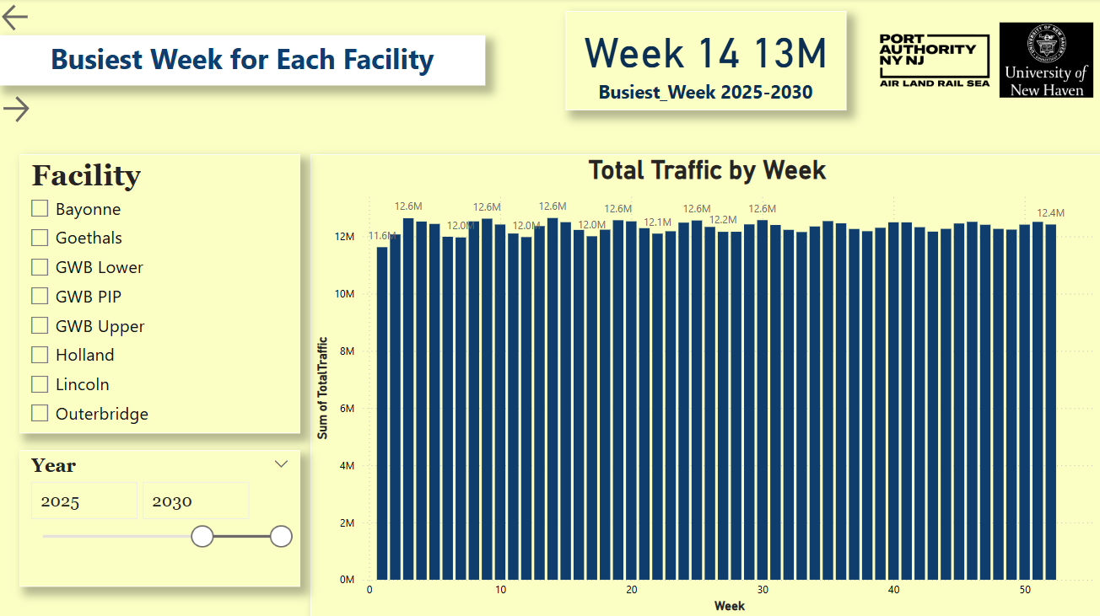

Slide 9
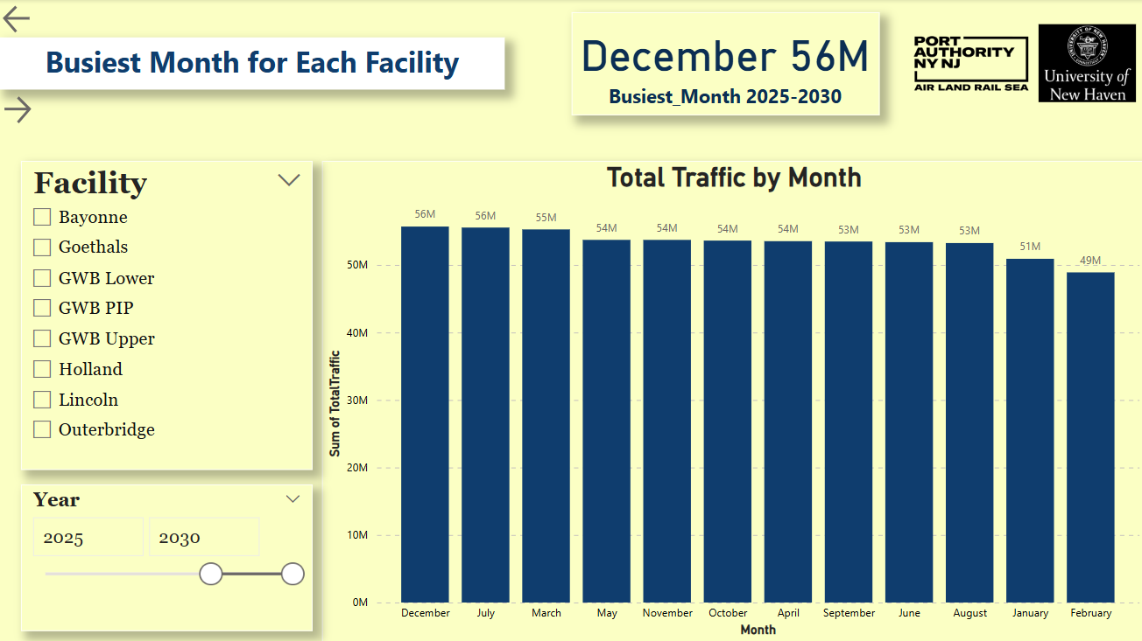

Slide 10
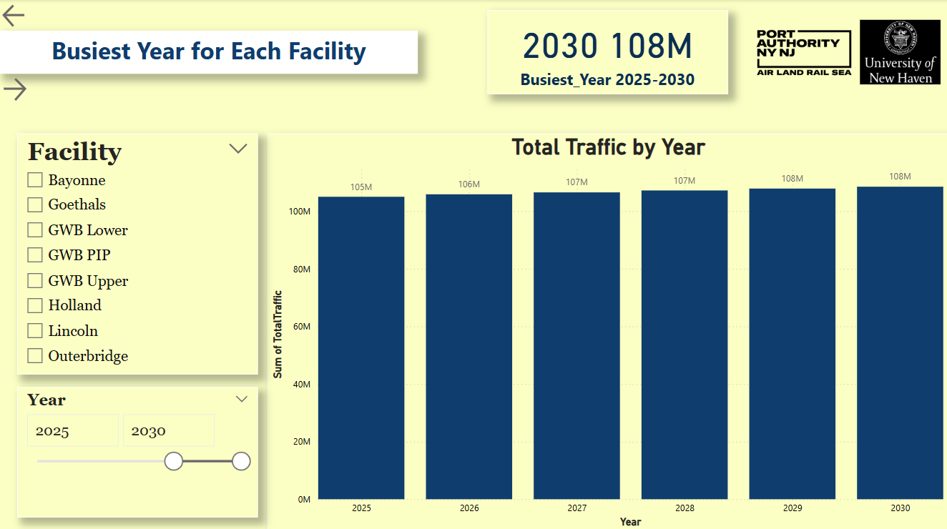

Slide 11
Question 5: How does our current usage compare to 2019 which is the last year before covid?
Post-COVID trends show a significant decline in bus ridership compared to 2019, with passenger volumes projected to stabilize around 145–165 million annually by 2025–2030, still below pre-pandemic levels.
Vehicle traffic is rising, with total vehicle count projected to reach 108 million annually by 2030, highlighting increased congestion despite stagnant public transit usage, requiring smarter traffic management and infrastructure planning.

Slide 12
Recommendations to the company.
Adapt
Adapt service models to reflect post-pandemic ridership, prioritizing high-demand routes for expansion.
Invest in
Invest in real-time data systems (e.g., sensors, mobile apps) for live monitoring and service adjustments.
Gather
Gather detailed data on commuter behavior to inform targeted recovery strategies.
Consider
Consider macroeconomic trends, government policies, and climate change in infrastructure planning.
Promote
Promote discounted fares and incentives through public-private partnerships to encourage transit use.

